Slide 1
Routing in the Internet
Forwarding versus Routing
Forwarding:
to select an output port based on destination address and routing table
Routing:
process by which routing table is built

Slide 2
UNICAST ROUTING
In an internet, the goal of the network layer is to deliver a datagram from its source to its destination or destinations.
If a datagram is destined for only one destination (one-to-one delivery)-→unicast routing.
Multicast routing---one-to-many
Broadcast routing --- one- to -all

Slide 3
General Idea
In unicast routing, a packet is routed, hop by hop, from its source to its destination by the help of forwarding tables.
The source host needs no forwarding table because it delivers its packet to the default router in its local network.
The destination host needs no forwarding table either because it receives the packet from its default router in its local network.
This means that only the routers that glue together the networks in the internet need forwarding tables.

Slide 4
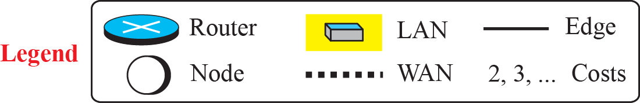
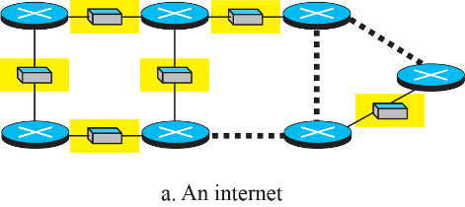
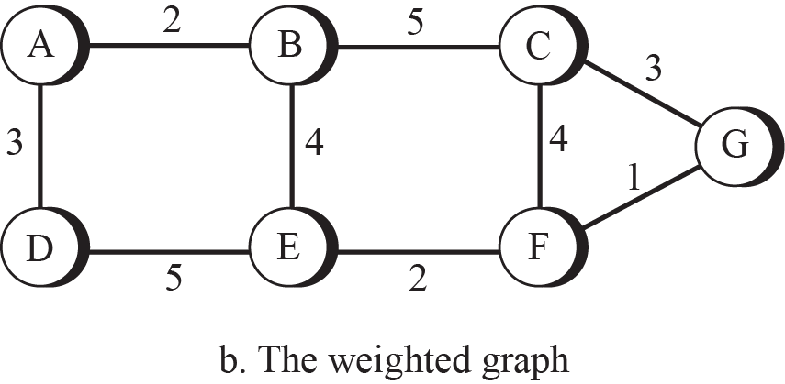
Graph abstraction
key question: what is the least-cost path between any two nodes ?
routing algorithm: algorithm that finds that least cost path
1.4

Slide 5
Routing Algorithm
Several routing algorithms have been designed in the past. The differences between these methods are in the way they interpret the least cost and the way they create the least-cost tree for each node.
The basic problem of routing is to find the lowest-cost path between any two nodes
Where the cost of a path equals the sum of the costs of all the edges that make up the path

Slide 6
Routing algorithm classification
Q: global or decentralized information?
global:
all routers have complete topology, link cost info
“link state” algorithms
decentralized:
router knows physically-connected neighbors, link costs to neighbors
iterative process of computation, exchange of info with neighbors
“distance vector” algorithms
Q: static or dynamic?
static:
routes change slowly over time
dynamic:
routes change more quickly
periodic update
in response to link cost changes
Two main classes of protocols
Distance Vector –uses Bellman Ford’s algorithm (RIP)
Link State – uses Dijkstra’s algorithm (OSPF)

Slide 7
Distance Vector Routing
Each node constructs a one dimensional array (a vector) containing the “distances” (costs) to all other nodes and distributes that vector to its immediate neighbors
Starting assumption is that each node knows the cost of the link to each of its directly connected neighbors.
A link that is down is assigned an infinite cost.

Slide 8
Distance Vector Routing
Next step – Every node sends a message to its directly connected neighbors containing its personal list of distances.
In the absence of any topology changes, after few exchanges every router knows the distance to every other router. This state is called Convergence state.
Then data will be forwarded as per the entries in the routing table.

Slide 9
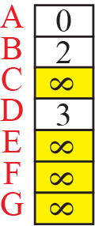
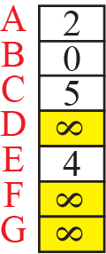
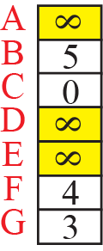
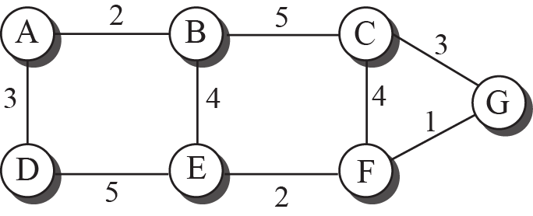
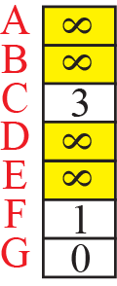
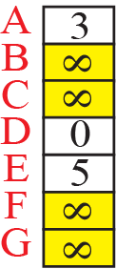
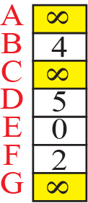
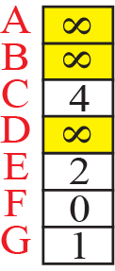
The first distance vector for an internet

Slide 10
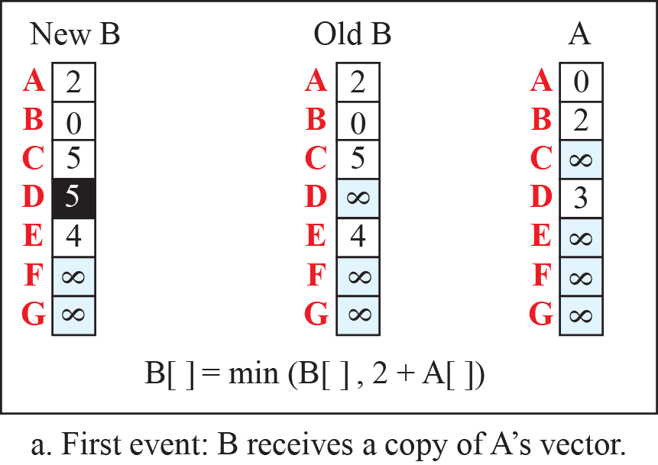
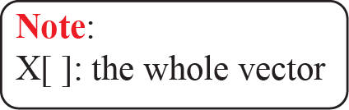
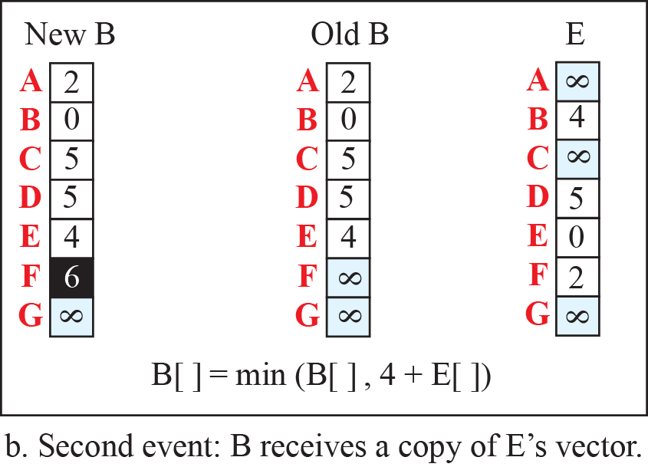
Updating distance vectors

Slide 11
The final distance vector for an internet
A | 0
B | 2
C | 7
D | 3
E | 6
F | 8
G | 9
A | 2
B | 0
C | 5
D | 5
E | 4
F | 6
G | 7
A | 7
B | 5
C | 0
D | 10
E | 6
F | 4
G | 3
A | 9
B | 7
C | 3
D | 8
E | 3
F | 1
G | 0
A | 3
B | 5
C | 10
D | 0
E | 5
F | 7
G | 8
A | 6
B | 4
C | 6
D | 5
E | 0
F | 2
G | 3
A | 8
B | 6
C | 4
D | 7
E | 2
F | 0
G | 1

Slide 12
Updates
Every T seconds each router sends its table to its neighbor. Each router then updates its table based on the new information (periodic updates)
Whenever there is a topology change then the router will send the triggered updates.

Slide 13
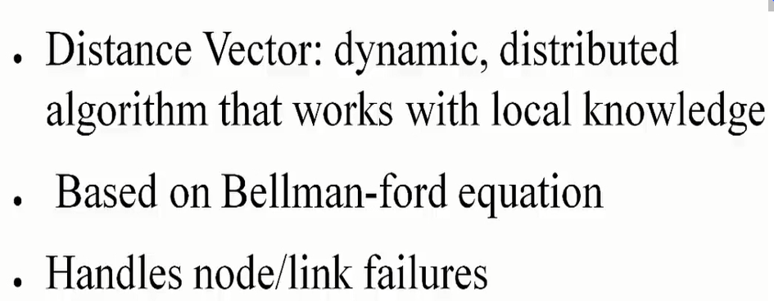
SUMMARY

Slide 14
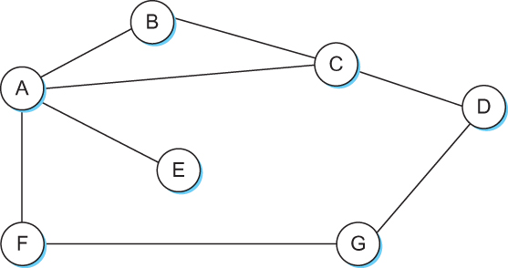
Distance Vector
When a node detects a link failure
F detects that link to G has failed
F sets distance to G to infinity and sends update to A
A sets distance to G to infinity since it uses F to reach G
A receives periodic update from C with 2-hop path to G
A sets distance to G to 3 and sends update to F
F decides it can reach G in 4 hops via A
Notes:
In this example Router F detects that its link to G has failed. F sets G to ∞ and updates A. Since A was using F to get to G it sets distance to G to ∞ and updates B, C, and E. Its next periodic update from C shows a route to G with cost 2. A sets costs to G to 3 and sends to F. F now sets cost to G to 4 through A.

Slide 15
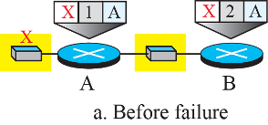
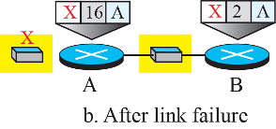
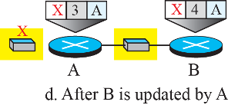
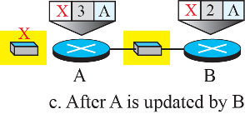
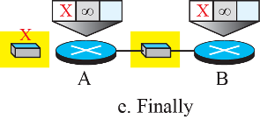
Two-node instability (count to infinity)

Slide 16
Link State Routing
Strategy: Send to all nodes (not just neighbors) information about directly connected links (not entire routing table).
Link state Routing uses two mechanisms:
1) Reliable dissemination of link state information
2) Route Calculation (formation of least cost trees)
Reliable flooding: give link state information from every node to everybody else in the network reliably.
Link State Packet (LSP)
id of the node that created the LSP
cost of link to each directly connected neighbor
sequence number (SEQNO)
time-to-live (TTL) for this packet
1 and 2 used for route calculation and
3 and 4 used for reliable flooding.

Slide 17
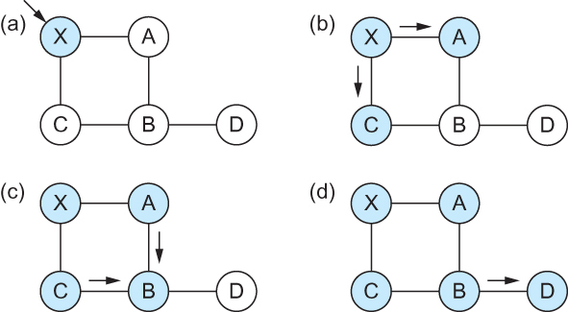
Link State Routing
Reliable Flooding
Flooding of link-state packets. (a) LSP arrives at node X;
(b) X floods LSP to A and C;
(c) A and C flood LSP to B (but not X);
(d) flooding is complete

Slide 18
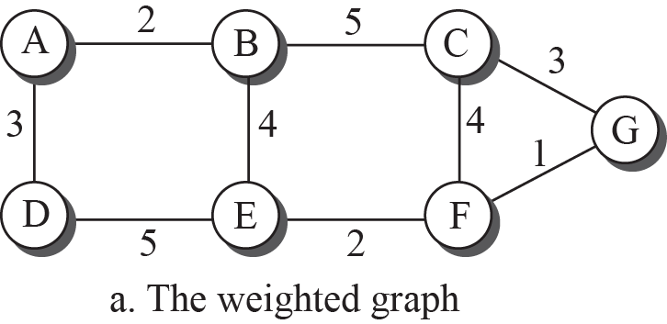
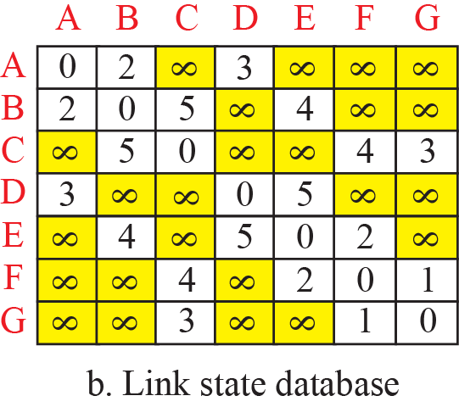
Example of a link-state database

Slide 19
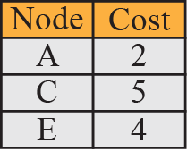
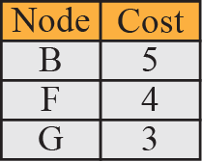
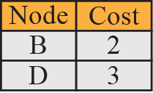
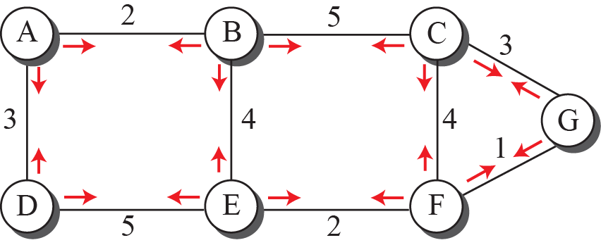
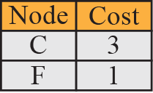
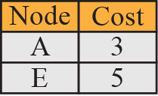
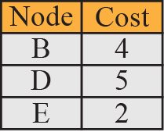
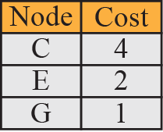
LSPs created and sent out by each node to build LSDB

Slide 20
Route calculation
Every node has the LSP from everybody else.
So each node has the full topology of the network (LSDB)
It uses the Dijkstra’s shortest path algorithm to calculate the best route to every destination.
Actually it creates a shortest path tree by keeping the source as the root. (by referring to LSDB)
Also called as Single Source Shortest Path problem

Slide 21
Shortest Path Routing
Dijkstra’s Algorithm - Assume non-negative link weights
N: set of nodes in the graph
l((i, j): the non-negative cost associated with the edge between nodes i, j ∈N and l(i, j) = ∝ if no edge connects i and j
Let s ∈N be the starting node which executes the algorithm to find shortest paths to all other nodes in N
Two variables used by the algorithm
M: set of nodes incorporated so far by the algorithm (processed nodes)
C(n) : the cost of the path from s to each node n
The algorithm
M = {s}
For each n in N – {s}
C(n) = l(s, n)
while ( N ≠ M)
M = M ∪ {w} such that C(w) is the minimum
for all w in (N-M)
For each n in (N-M)
C(n) = MIN (C(n), C(w) + l(w, n))

Slide 22
Route calculation
Specifically each switch maintains two lists, known as Tentative and Confirmed
Each of these lists contains a set of entries of the form (Destination, Cost, NextHop)
Algorithm:
Initialize the Confirmed list with an entry for source; this entry has a cost of 0
For the node just added to the Confirmed list in the previous step, call it node Next, select its LSP
For each neighbor (Neighbor) of Next, calculate the cost (Cost) to reach this Neighbor as the sum of the cost from myself to Next and from Next to Neighbor
If Neighbor is currently on neither the Confirmed nor the Tentative list, then add (Neighbor, Cost, Nexthop) to the Tentative list, where Nexthop is the direction I go to reach Next
If Neighbor is currently on the Tentative list, and the Cost is less than the currently listed cost for the Neighbor, then replace the current entry with (Neighbor, Cost, Nexthop) where Nexthop is the direction I go to reach Next
If the Tentative list is empty, stop. Otherwise, pick the entry from the Tentative list with the lowest cost, move it to the Confirmed list, and return to Step 2.

Slide 23
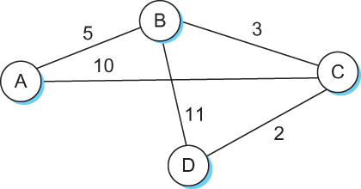
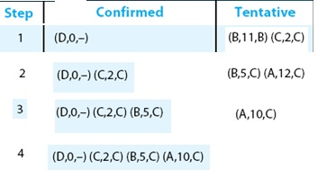
Shortest Path Routing
Source: D

Slide 24
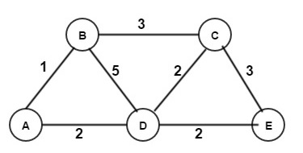
Consider the following network Topology. Apply Dijkstra’s Algorithm to calculate the shortest path from node B to every other node.
N’ | D(v) A B C D E | w
{B} | 1, 0, 3, 5, INF | A
{B, A} | 1, 0, 3, 3, INF | C
{B, A, C} | 1, 0, 3, 3, 6 | D
{B, A, C, D} | 1, 0, 3, 3, 5 | E
{B, A, C, D, E}
Source Vertex : B

Slide 25
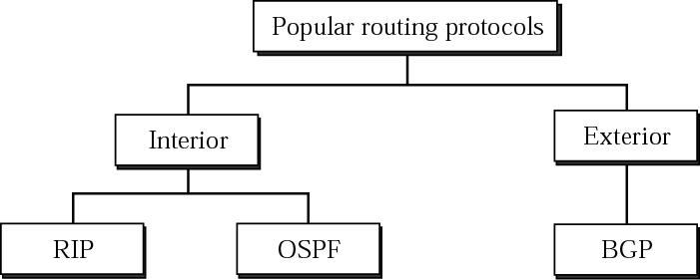
Routing Protocols RIP, OSPF, BGP
Dynamic protocols
Sharing neighborhood information
Use different metrics.
RIP (one hop count, how many networks a packet crosses), Networks are treated equally
BGP (depend on the policy, set by administrator)
OSPF (TOS, minimize delay, maximize throughput)
Notes:
Border Gateway Protocol, Open Shortest Path First ,

Slide 26
RIP ( Routing Information Protocol)
included in BSD-UNIX distribution in 1982
distance vector algorithm
distance metric: # hops (max = 15 hops), each link has cost 1
DVs exchanged with neighbors every 30 sec in response message (aka advertisement)
each advertisement: list of up to 25 destination subnets (in IP addressing sense)
from router A to destination subnets:
u
v
subnet hops
u 1
v 2
w 2
x 3
y 3
z 2
A
B
w
x
z
C
D
y

Slide 27
OSPF (Open Shortest Path First)
“open”: publicly available
uses link state algorithm
LS packet dissemination
topology map at each node
route computation using Dijkstra’s algorithm
OSPF advertisement carries one entry per neighbor
advertisements flooded to entire AS
carried in OSPF messages directly over IP (rather than TCP or UDP)

Slide 28
Internet inter-AS routing: BGP
BGP (Border Gateway Protocol): the de facto inter-domain routing protocol
The goal of Inter-domain routing is to find some loop free path to the intended destination
We are concerned with reachability than optimality
BGP provides each AS a means to:
obtain subnet reachability information from neighboring AS’s: eBGP
propagate reachability information to all AS-internal routers: iBGP
determine “good” routes to other networks based on reachability information and policy.

